Slide 1

Introduction to
Statistics Hypothesis Testing
Eslam Ahmed
Software Engineer

Slide 2
Hypothesis Testing

Slide 3
What is Hypothesis?
An idea or explanation of something that is based on a few known facts but that has not yet been proved to be true or correct.
-- Oxford Dictionary

Slide 4
What is Hypothesis?
Testing a known assumption that is generally accepted as the truth.
Testing a claim that is supposed to change the current facts.

Slide 5






Null Vs Alternate Hypothesis
H₀
H_{a}
There is no change from the stated facts.
The stated facts are incorrect
Chocolate bars weigh 100 gms or more
Chocolate bars weigh less than 100 gms
=
≤
≥
≠
<
>

Slide 6
Statistical Significance

Slide 7
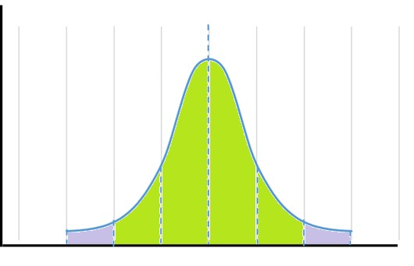

Statistical Significance
H₀
H_{a}
We expect this to happen.
We don’t expect this.
It happened.
Still it happened.
Nothing changes.
Null Hypothesis is true.
Status quo remains.
Null Hypothesis rejected.
Status quo or claim is rejected

Slide 8

Important terms – Statistical Significance
95% Probability
P → Observed or seen Probability of the sample
P < α
Rejection Region Probability of rejection region → α
Reject Null Hypothesis

Slide 9
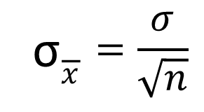
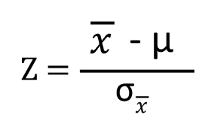
Hypothesis Testing
Current average waiting period for the customers who call the customer service helpline is 100 seconds with a standard deviation of 20 seconds. Certain changes were recently done to the IVR menu options as well as the overall customer service processes. After a week, the management picked-up a sample of 100 calls and found that the average waiting period was 95 seconds. Have the process implementations resulted in the waiting period reduction?
H₀
H_{a}
State Population parameters and Sample statistics
μ = 100; σ = 20; N = 100; X = 95;
Compute Sample Standard Deviation and Z-Value
: null hypothesis : There is no change in the waiting period.
: alternate hypothesis : The waiting period has reduced.
Significance Level; α = 0.05 or 5%
3. Compute ρ using Z-Score for the Z-value
ρ = 0.62%

Slide 10
Hypothesis Testing
Current average waiting period for the customers who call the customer service helpline is 100 seconds with a standard deviation of 20 seconds. Certain changes were recently done to the IVR menu options as well as the overall customer service processes. After a week, the management picked-up a sample of 100 calls and found that the average waiting period was 95 seconds. Have the process implementations resulted in the waiting period reduction?
H₀
H_{a}
ρ < α
Population parameters and Sample statistics
; σ = 20; N = 100; X = 95;
pute Sample Standard Deviation and Z-Value
1. State
he waiting period. _{μ = 100}
2. Com
d has reduced.
: null hypothesis : There is no change in t
: alternate hypothesis : The waiting perio
Reject Null
Significance Level; α = 0.05 or 5%
3. Compute ρ using Z-Score for the Z-value
ρ = 0.62%

Slide 11
Thank You!

